Slide 1
Cs 207 Project
LASER SECURITY SYSTEM

Slide 2
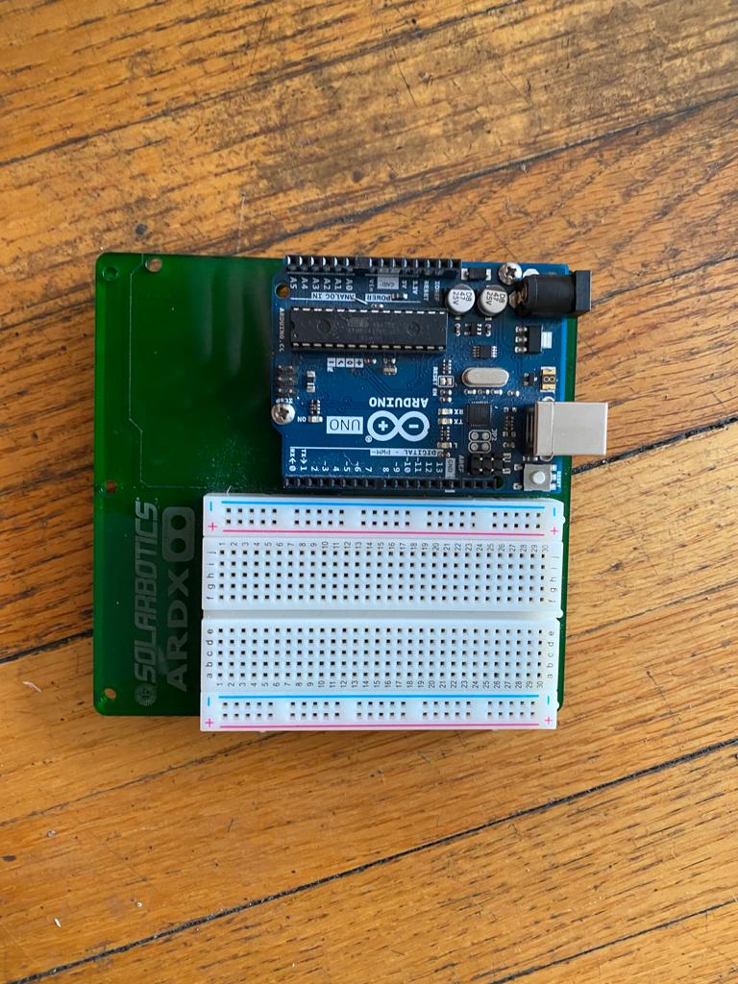
Arduino and Breadboard

Slide 3
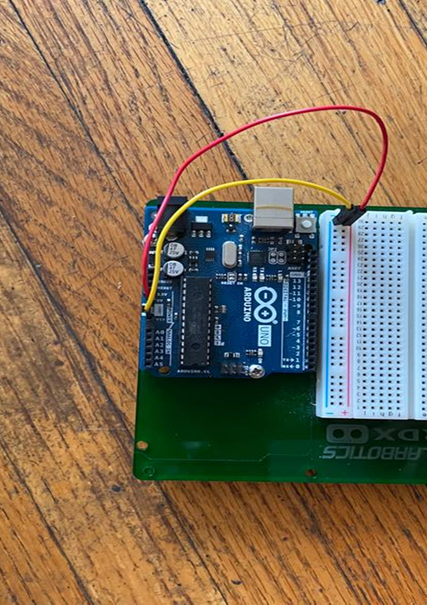
First, connect Arduino with breadboard
5 Volts with (+)
Ground with (-)

Slide 4
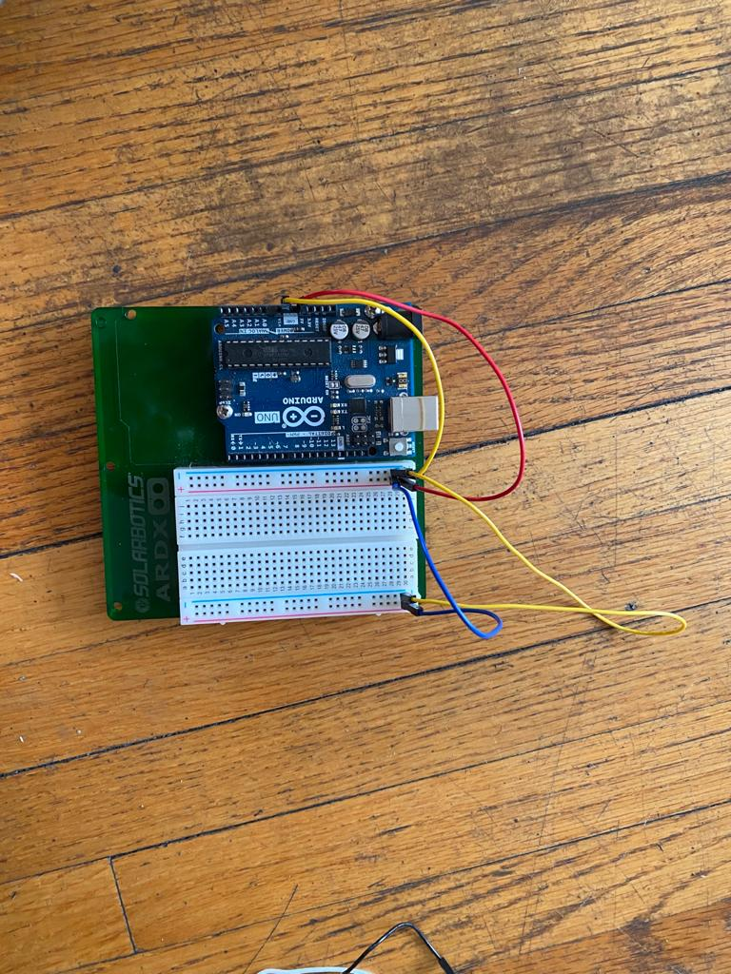
Connecting on the other side of breadboard
5 Volts with (+)
Ground with (-)

Slide 5
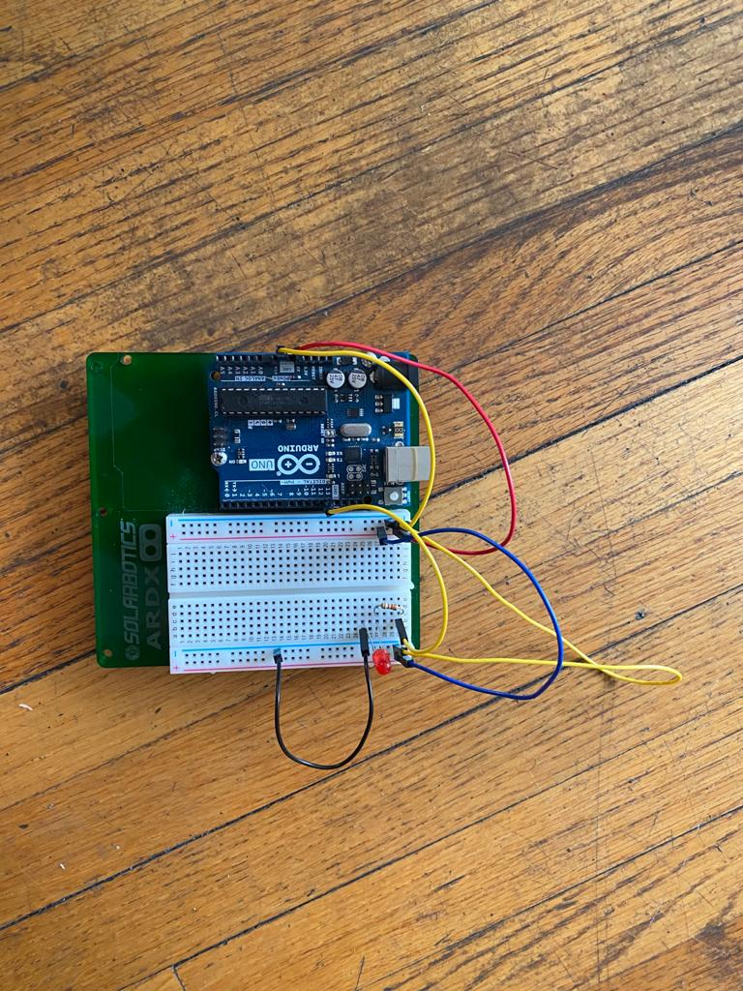
Red led
Connect pin 13 to positive leg of led.(use resistor in between pin 13 and + leg)
Connect (-) side of led to ground.

Slide 6
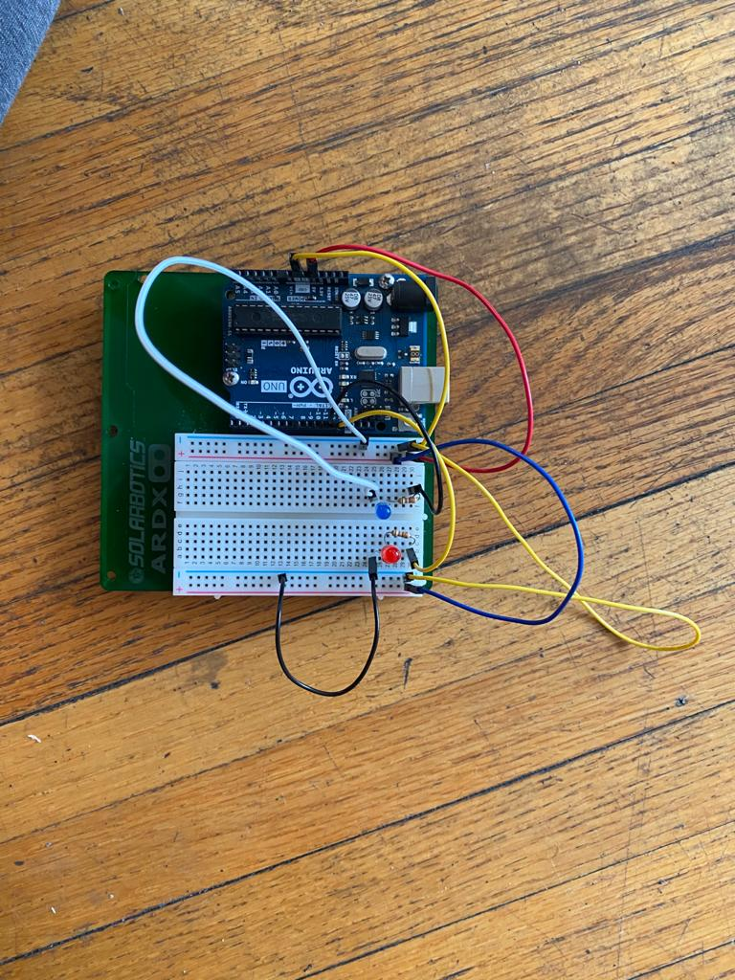
Blue led
Connect pin 12 to positive leg of led.(use resistor in between pin 12 and + leg)
Connect (-) side of led to ground.

Slide 7
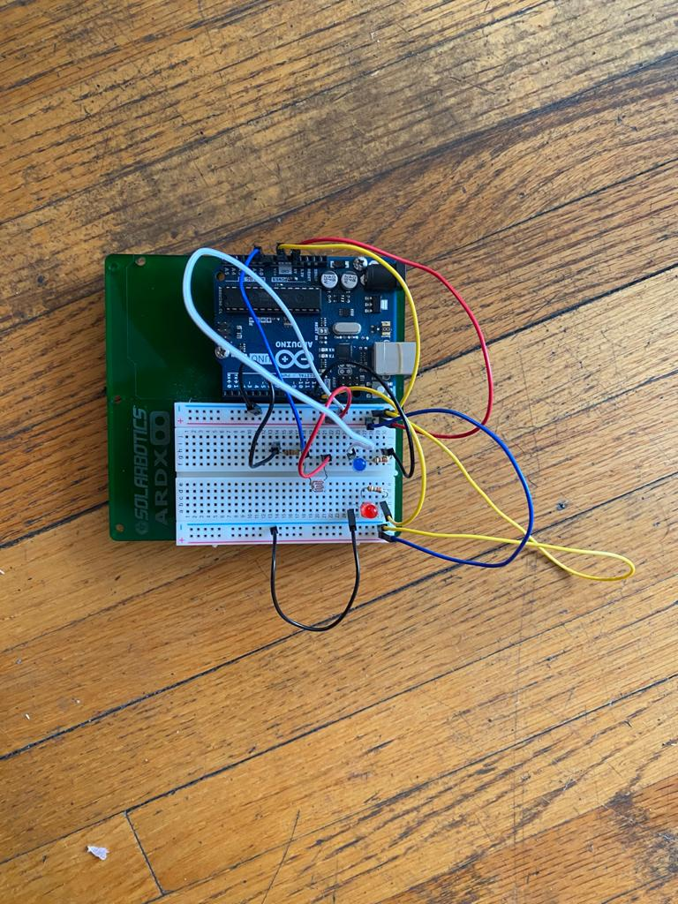
photoresistor
Connect (+) leg of photoresistor to 5v
Connect ground and A0 of photoresistor to –ve leg.
You can use resistor on either side.

Slide 8
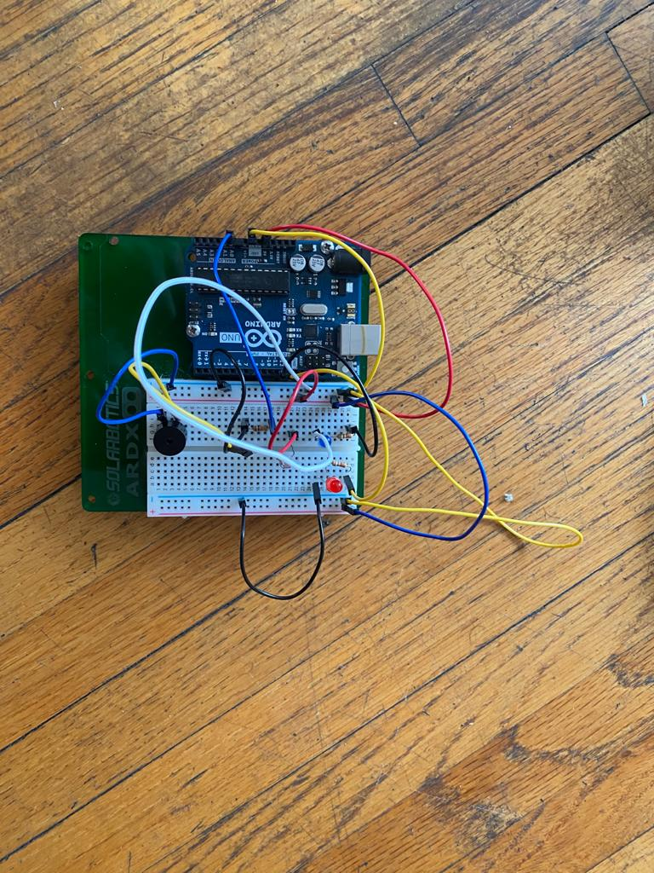
buzzer
Connect (+) leg of buzzer in pin 9
Connect ( - ) leg of buzzer to ground.

Slide 9
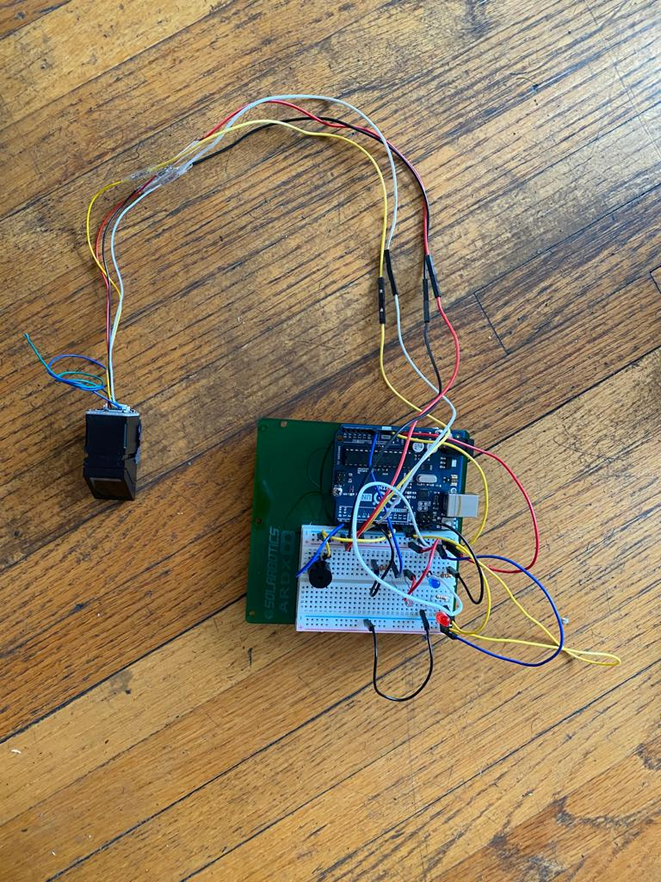
Fingerprint sensor
There are 4 wires in fingerprint sensor.
Red – connect in (+) 5v
Black – connect to ( - ) ground
White – Connect to pin 3
Yellow - Connect to pin 2

Slide 10
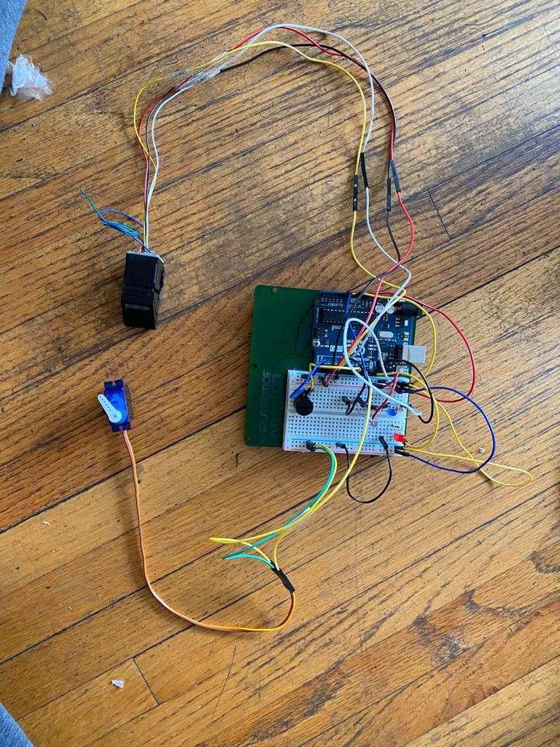
Servo
There are 3 wires connecting to Arduino
Red – connected to (+) 5v.
Brown – connected to ( - ) ground
Yellow – Connected to pin 11.

Slide 11
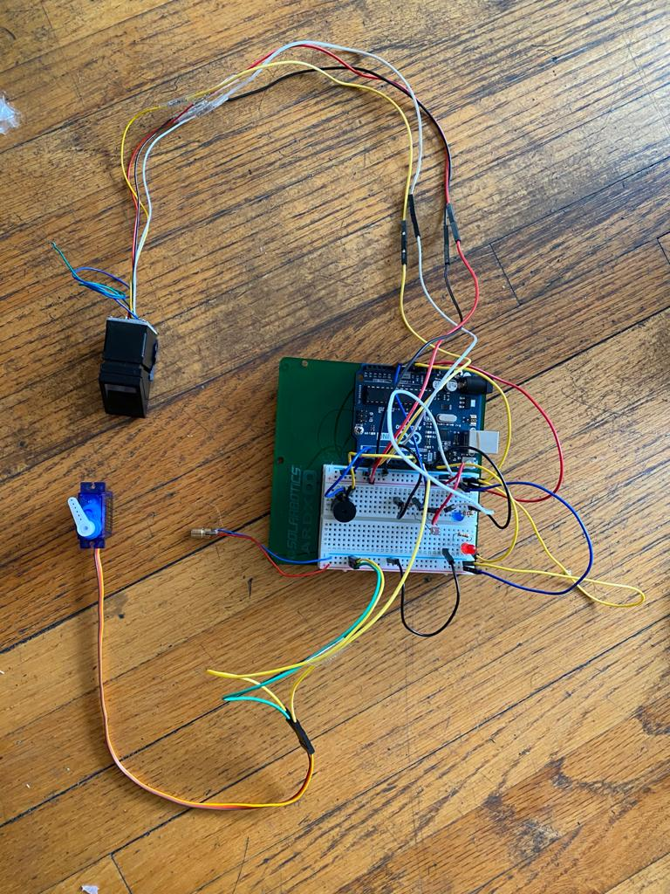
Laser light
We have connected laser light using another Arduino. But you can use in same Arduino to give power.
Connect one end to 5 Volts
Connect other end Ground

